Slide 1

SQL Server Admin Best Practices with DMV's
William Assaf

Slide 2
SQL Server Admin Best Practices with DMV's
An incomplete tour of SQL Server DMV’s, covering the most important topics and getting you started on getting the most you can out of these crucial performance indicators.

Slide 3
Audience
Everyone can benefit from knowledge of these helpful tools, from developers to report writers to DBA’s of all levels of experience.

Slide 4
Purpose of this Presentation
There are far too many DMVs to be covered in the scope of this presentation, here are the most useful and popular.
Getting anything out of DMVs will require you to try them yourself.
Short, quick-hitting labs throughout.
We won’t get to all Labs, but you can!
Share practical, everyday uses and scripts.

Slide 5
Don’t worry
Slides and samples will be posted on my blog at SQLTact.com
Some labs use Microsoft’s WideWorldImporters sample database: https://github.com/Microsoft/sql-server-samples/releases/tag/widWideWorldImporters-Full.bake-world-importers-v1.0
All Labs on Github: github.com/SparkHoundSQL/sql-server-toolbox

Slide 6
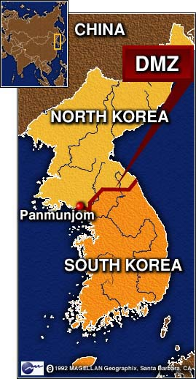

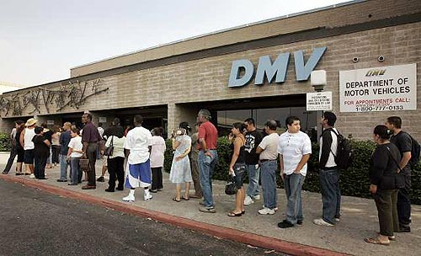




What Is a DMV?
Dynamic Management Views are in place to provide system transparency.
The DMV’s we are talking about today are the foundation of countless third party SQL monitoring applications.

Slide 7
What Is a DMV?
They all fall into a category of DMO’s.
Some are DMF’s, table-valued Functions with parameters.
For this presentation, I called them all DMV’s, because I can make more jokes about DMV’s.
Notes:
They could also be called DMO’s, Dynamic Management Objects, but that acronym is already taken by Distributed Management Objects.

Slide 8
What Is a DMV?
Most DMO’s in this session work (at least partially) back to SQL 2005 (database compatibility level 90).
Some database-level DMV’s require the database to be in the needed compatibility mode or higher
Some towards the end of the presentation have been introduced more recently, including some in SQL 2019
Often, DMV changes are pushed to older versions via SP.
Most of this content applies to SQL Server, Azure SQL, SQL Server on Linux, and Azure SQL Managed Instance.

Slide 9
Permissions
Most DMV’s require only:
VIEW SERVER STATE
or
VIEW DATABASE STATE
grant view server state to [domain\group] grant view database state to [domain\group]
These are no-data permissions that may be appropriate for developers in your production environment.

Slide 10
sys.dm_os_wait_stats
Aggregated wait times – records when something has to wait and retains it.
Records count of tasks experiencing the wait type, sum of time and max time waiting.
1069 (more or less documented) wait types in SQL 2019 RC1, an increase of seven wait types from SQL 2019 CTP3.2.
Notes:
Best to exclude types that match ‘%SLEEP%’ because those are related to db system startup waits or background task waits and shouldn’t be considered part of user performance.

Slide 11
sys.dm_os_wait_stats
Wait Stats can be powerful diagnostic tools.
Many performance suits do little more than incorporate Wait Stats data for charts in their dashboards, but they also are great sponsors of user groups and SQLSaturday events!

Slide 12
sys.dm_os_wait_stats
ONDEMAND_TASK_QUEUE – high wait times of this type indicate lots of SQL Server idle time. You can ignore/disregard this.
There are many innocuous wait times that are no cause for concern:
BROKER_TRANSMITTER BROKER_RECEIVE_WAITFOR DBMIRROR_WORKER_QUEUE KSOURCE_WAKEUP CLR_AUTO_EVENT LOGMGR_QUEUE REQUEST_FOR_DEADLOCK_SEARCH QDS_SHUTDOWN_QUEUE
and many many more..
Good resource here: https://www.sqlskills.com/blogs/paul/wait-statistics-or-please-tell-me-where-it-hurts/

Slide 13
sys.dm_os_wait_stats
LCK_M_* - Lock waits
Reference sys.dm_tran_locks if this number is consistently at the top of the server’s waits.
This is a sign of transaction contention.
Could be that poor queries/indexing are creating too many scans, where a nonclustered index seek could relieve this pressure.
Synchronous Availability Group replicas could increase this wait.
Lots of LCK_M_ waits?
Consider RCSI – Read Committed Snapshot Isolation
Stop adding NOLOCK to your queries, this is dangerous.

Slide 14
sys.dm_os_wait_stats
CXPACKET – clear indication of excessive execution plan parallelism and CPU is struggling to keep up.
Look into Max Degree of Parallelism (MAXDOP) and Cost Threshold for Parallelism (CTFP), it may be appropriate to reduce parallelism to improve performance.
MAXDOP can be configured server-wide, but also in recent versions of SQL Server, at the query level or database level.
Enforcing MAXDOP is one of the better uses of the Resource Governor (Enterprise-only) for select connections.

Slide 15
sys.dm_os_wait_stats
SQL Server 2017 CU3 introduced a split – CXPACKET is split between CXPACKET and CXCONSUMER.
CXPACKET would be incurred by both threads that consume and produce data in query plan. Producer threads were most problematic, most impacted by the parallelism, and most affected by out-of-date statistics.
So you have more control over the problematic producer threads still reported by CXPACKET. The consumer threads are now reported by CXCONSUMER.
As a result, after SQL Server 2017 CU3 and SQL Server 2016 SP2 and SQL 2019, CXPACKET will be lower.

Slide 16
sys.dm_os_wait_stats
SOS_SCHEDULER_YIELD – clear indication of CPU pressure when this is the highest wait
Too many runnable tasks for available threads
A SQL stopped operation and “yielded” to another CPU task
Increasing CPU is the simplest but most difficult and expensive
Look for and reduce CPU-intense queries (more on how later)

Slide 17
sys.dm_os_wait_stats
OLEDB– describes waits associated with external communication via the OLE DB provider.
Commonly used by SQL Server Integration Services (SSIS) packages, Microsoft Office applications (including querying Excel files), linked servers using the OLE DB provider, and third party tools.
It could also be generated by internal commands like DBCC CHECKDB.

Slide 18
sys.dm_os_wait_stats
RESOURCE_SEMAPHORE – request is waiting on memory to be gathered before starting
Indication of memory pressure caused by:
Insufficient system memory (unlikely)
Poor query design, poor indexing, inefficient execution plan (likely)

Slide 19
sys.dm_os_wait_stats
PAGELATCH_xx - Nothing to do with Physical IO. Multiple threads are attempting to access a page in memory. Contention over a page in memory.
Could be tempdb temp tables are being overused.
Could be an INSERT statement hotspot on a table.
PAGEIOLATCH_xx – This is Physical IO, reading data from disk into memory. Hard disks/SAN are struggling to keep up.
Often this is because of inefficient application code
Or, executives/analysts/goons are running MS Access or Excel and pulling down entire tables

Slide 20
sys.dm_os_wait_stats
PAGELATCH_xx - New in SQL 2019 - A new index option OPTIMIZE_FOR_SEQUENTIAL_KEY specifically for tables with clustered keys on IDENTITY or SEQUENCE that have rapid writes, creating “hot spots” for sequential inserts.
If you observe high amounts of PAGELATCH_EX, it may be because of contention for pages in memory. This new index option improves performance for tables that have a sequential key. https://docs.microsoft.com/en-us/sql/t-sql/statements/create-index-transact-sql?view=sqlallproducts-allversions#sequential-keys

Slide 21
sys.dm_os_wait_stats
PAGELATCH_xx - New in SQL 2019 - If long PAGELATCH_* waits are encountered on TempDB system resources, a new feature of SQL Server 2019 may improve performance.
The new Memory-Optimized TempDB Metadata option moves tables containing TempDB metadata into non-durable memory-optimized tables.
No latches, no more “hot spots”.
https://docs.microsoft.com/en-us/sql/relational-databases/databases/tempdb-database?view=sqlallproducts-allversions#memory-optimized-tempdb-metadata

Slide 22

sys.dm_os_wait_stats
ASYNC_NETWORK_IO – Common, caused by waits involving the reception of data by the remote clients.
Almost certainly not caused by the network.
Almost certainly caused by poor queries, such as SELECT *’s with no WHERE clause
Look for queries with high row counts
Will be caused by Office apps that query entire tables →

Slide 23
sys.dm_os_wait_stats
When to analyze?
Use on healthy or troubled systems, look for trending from a baseline.
Determine which waits are impacting performance server-wide. It is one of the best DMV’s for server-wide performance.

Slide 24
sys.dm_os_wait_stats
This number is a forever-growing aggregate.
Which means over time, recent changes will not affect the large aggregate numbers well.
For your performance-sensitive servers, consider a regimen of collection and manual wiping the stats weekly or daily.
Lab: dm_os_wait_stats.sql

Slide 25

sys.dm_os_wait_stats
Again, sys.dm_os_wait_stats is aggregated at the instance level.
Doesn’t include live data.
Doesn’t include request- or session-level data.
For that you’ll need the next DMV…

Slide 26
sys.dm_os_waiting_tasks
Shows waits for current requests, not aggregated.
Not much different from the current wait information in sys.dm_exec_requests (more on that important DMV later)

Slide 27
sys.dm_exec_session_wait_stats
Shows waits for the current session.
Instead of server-wide waits or current waits, we can drill into specific query waits aggregated with the session so far, since it connected.
The syntax is the same as the aggregated sys.dm_os_wait_stats, but includes an extra column for session_id.

Slide 28
Summary of Wait Type DMV’s
Labs:
dm_os_wait_stats.sql - Aggregate Waits
dm_os_waiting_tasks.sql – Live Session-level Waits
dm_exec_session_wait_stats.sql – Aggregate Session-level Waits

Slide 29
sys.dm_exec_query_stats
Stores performance information about the cached query plans in memory, but rows do not persist after a plan is removed from cache (or an instance restart).
Provides a sql_handle and offsets (integers) to identify the statement within a batch or stored procedure using sys.dm_exec_sql_text.
One row per query statement within cached plan.

Slide 30
sys.dm_exec_query_stats
Used for in-depth performance tuning.
Find the “worst” queries in terms of total_worker_time (CPU), rows affected, and duration.
Records total writes, total reads and can be used in summary to measure activity.

Slide 31
sys.dm_exec_query_stats
Lab: Worst query plans.sql
But wait! SQL 2016+’s Query Store feature contains more and better data and functionality.
Query Store is SO GOOD, that I no longer recommend using a “Worst Query Plans” script based on sys.dm_exec_query_stats in SQL 2016+. Enable Query Store! It is NOT enabled by default.

Slide 32
Query Store
New in SQL 2016, starting with SQL 2017, Query Store tracks Wait Stats too!
Tracks the performance of queries – not of execution plans – a distinct difference. Can detect when a query has suffered a degradation in performance because its query plan has changed.

Slide 33
Query Store
While the “worst plans in cache” had been a strategy to identify the most expensive plans, the Query Store is one step better – finding the recent “worst queries” regardless of plan, with sortable/aggregable metrics to launch your performance tuning.

Slide 34
Query Store – Next Logical Step?
What if SQL Server could use information about Regressed Queries and a history of execution plans to decisions to automatically use a better plan?
Now it can!
Automatic Plan Correction (new to SQL 2017)!
Azure SQL Database already does this for you!

Slide 35
Automatic Plan Correction
“Automatic Plan Tuning” is based on Query Store
Available in Azure SQL and now in SQL 2017 to revert a query from a newer, slower plan to an older, faster plan.

Slide 36
Automatic Plan Correction
You can also accomplish this manually yourself, or query the underlying information yourself, with a host of DMV’s including sys.dm_db_tuning_recommendations.
Sample: https://docs.microsoft.com/en-us/sql/relational-databases/automatic-tuning/automatic-tuning

Slide 37
Automatic Plan Correction
Not on by default, you must enable
Database Engine will automatically force any recommendation where the estimated CPU gain is higher than 10 seconds.
ALTER DATABASE WideWorldImporters
SET AUTOMATIC_TUNING ( FORCE_LAST_GOOD_PLAN = ON );

Slide 38
sys.dm_exec_sessions
Queryable session info
Includes connection identification info
Replaces the old system view sys.sysprocesses
Often joined to…

Slide 39
sys.dm_exec_requests
Shows current activity, like “SP_WHO2 active”
Shows only active requests
Main hub for many DMO’s providing request info, often joined with others.
Provides a sql_handle and offsets (integers) to identify the statement within a batch or stored procedure using sys.dm_exec_sql_text

Slide 40
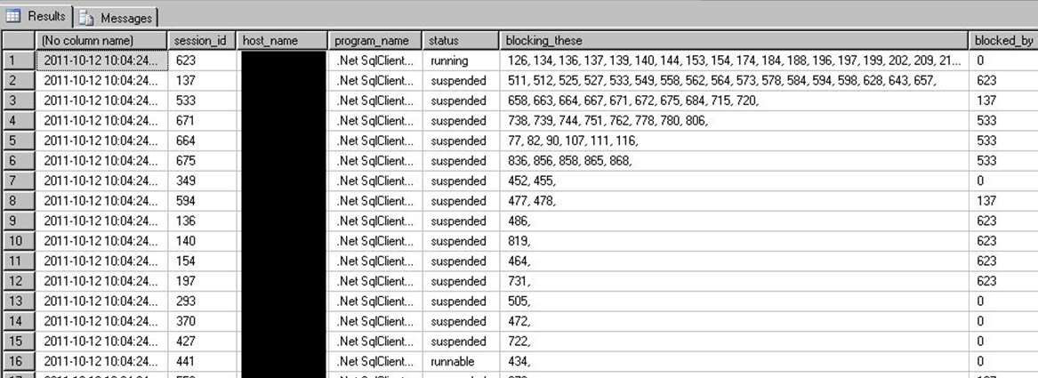
Sessions + Requests
Put them together for a status query far more detailed than SP_WHO2! Lab: sessions and requests.sql

Slide 41
sys.dm_exec_requests
Use the helpful percent_complete column to check progress of BACKUP and RESTORE.
Also applies to DBCC CHECKDB operations!
Combined with the start_time value, can estimate a completion datetime as well.
Lab:
Backup restore progress.sql

Slide 42
sys.dm_exec_input_buffer
DBCC INPUTBUFFER still not deprecated.
But has been effectively replaced by a new DMF sys.dm_exec_input_buffer.
This can display the last command issued from a session, even if there is no live request.

Slide 43
Index DMV’s YOU Should KNOW
Physical stats DMV’s:
Help you evaluate need for index maintenance
Missing Index DMV’s:
Help you design new indexes
Index Usage Stats DMV:
Helps you evaluate existing index usage

Slide 44
sys.dm_db_index_physical_stats
Determine index fragmentation to do SQL-level defrag.
Root of all index fragmentation monitoring queries.
avg_fragmentation_in_pct shows logical fragmentation for indexes and extent fragmentation for heaps.
Replaces the functionality of DBCC SHOWCONTIG to an extent.
(that’s a pun, get it?)

Slide 45
sys.dm_db_index_physical_stats
Will still show tables without clustered indexes as index_id = 0, this is a HEAP.
Almost always, a heap is poor design or an oversight.
However, heap fragmentation isn’t meaningful.
Index_ID = 1 is the clustered index.
Index_ID >= 2 is every other index.

Slide 46
sys.dm_db_index_physical_stats
Avg_fragmentation_pct is a scale of 0 (not fragmented) to 100 (perfectly fragmented)
You may find it beneficial to perform some sort of index maintenance when avg_fragmentation_pct > 10, but this may vary.
You may find a better balance of meaningful performance protection and logged maintenance activity with less aggressive maintenance > 50.

Slide 47
INDEX MAINTENANCE
ALTER INDEX … REORGANIZE replaces
old DBCC INDEXDEFRAG
ALTER INDEX … REBUILD replaces old DBCC DBREINDEX, also updates the statistics
ALTER INDEX … REBUILD ALL rebuilds all indexes on a table, also updates the statistics, but not recommended.

Slide 48
sys.dm_db_index_physical_stats
When to use?
Use while your application is in production to identify tables that are generating fragmentation over time.
Then, only perform index maintenance on individual indexes as needed, and then, potentially only on partitions of indexes.

Slide 49
Index Maintenance
Ideal: defrag the most fragmented in every maintenance window, “take the top off” the stack.
Custom scripts should use this selective approach.
SSMS Maintenance Plans since SQL 2016 have dramatically increased capability to perform complex, conditional index maintenance operations.
You can configure the REORGANIZE and REBUILD tasks to maintain only indexes filtered by percentage of fragmentation level, or page count.

Slide 50
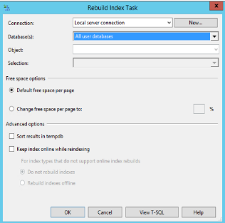
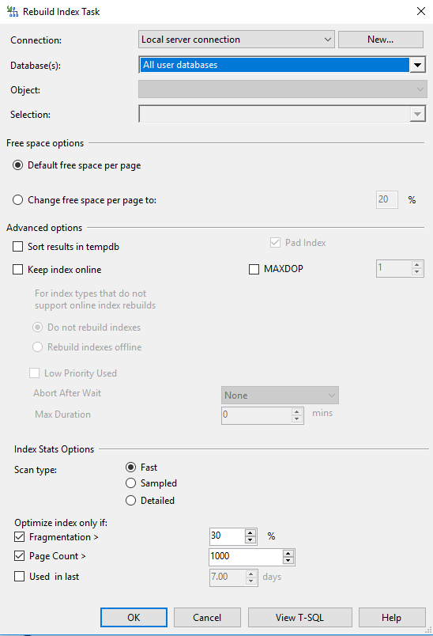
Index Maintenance
Rebuild Index Task
SQL 2014 vs SQL 2017

Slide 51
sys.dm_db_index_physical_stats
MODE parameter options for Scan Depth:
LIMITED
Fastest, default, because it only scans parent-level pages, not leaf.
Only returns basic metrics, leaves the rest NULL.
Still can impact on performance on LIMITED mode.
SAMPLED
Not as fast, samples 1% of leaf pages.
DETAILED
Much more involved. Scans all data pages. Will hammer your Disk IO.
Only way to get some of the columns to populate, but rarely needed.

Slide 52
sys.dm_db_index_physical_stats
Lab:
*lab - fragmented table.sql
*defrag.sql
automated index rebuild.sql

Slide 53
Aside, on Fragmentation
Why did the Microsoft Windows 7 RC download page break?
http://www.sqlskills.com/BLOGS/PAUL/post/Why-did-the-Windows-7-RC-failure-happen.aspx
Notes:
See this still happening in Microsoft products, including CRM.

Slide 54
dm_db_column_store_row_group_physical_stats
Columnstore indexes have their own DMV for rowgroup status and fragmentation, sys.dm_db_column_store_row_group_physical_stats
You need to include this DMV in any of your maintenance scripts if you have Columnstore indexes (and you probably should, they’re awesome SQL 2016+!)
Since Columnstore indexes are read-only prior to SQL 2016, this wasn’t needed in SQL 2012 or SQL 2014.

Slide 55
dm_db_column_store_row_group_physical_stats
You may find it necessary to REORGANIZE a Columnstore index multiple times before the rowgroups are compressed and the delta store rowgroups are moved to TOMBSTONE status.
Lab: Defrag Columnstore.sql

Slide 56
Missing Indexes Views
My favorite feature of introduced by SQL 2005.
A set of DMV’s record whenever a query plan recognized the need for an index that could have improved performance.
SQL records that recognized need, along with estimated statistics on cost and improvement of the new index.

Slide 57
Missing Indexes Views
sys.dm_db_missing_index_groups
sys.dm_db_missing_index_group_stats
sys.dm_db_missing_index_details
Passive. Already running. Doesn’t need to be enabled.
Cleared out when the server is rebooted, also cleared out for a table when you alter the table or indexes on that table.
Only recommends nonclustered indexes.
Won’t recommend a clustered index on a heap, you have to fix that!
Won’t recommend columnstore, xml, spatial index types.

Slide 58
Missing Indexes Views
Must be used with sobriety. Don’t create every suggested missing index or your update/insert/deletes will suffer.
Nonclustered Indexes exist physically as copies of your table, and must be kept up to date too, thus the overhead cost to every write. However,
Writes can benefit from nonclustered indexes by making the source query more efficient.

Slide 59
Missing Indexes Views
Indexes should be created to help many queries,
many index suggestions.
Suggestions may only differ only by the columns in the key vs. INCLUDE’d, or by a small number of columns.
Combine suggestions together with common key columns in the same order starting, and a combined INCLUDE list.
Combine with existing indexes on the table as well, potentially replacing an old index.
However, be careful not to change the uniqueness of the table. A unique index = a unique constraint.

Slide 60
Missing Indexes Views
When to use?
After recording actual usage in production.
Don’t use during development, too misleading.
Do use during user testing to simulate actual usage.
Do use on your production environment after a stable period of active and typical activity.
Try to capture a business cycle (weekly payroll, month-end reporting, quarterly or annual, etc.)

Slide 61
Final Note on Missing Indexes Views
Since SQL 2008 – Missing index views have been integrated into the show query plan screens in SSMS.
But don’t use this to create new indexes. Very few queries are important enough to deserve their own indexes.
Take a look at the whole picture, including all suggested indexes and all existing indexes before creating any indexes.
Treat this as an alert, but don’t use it!

Slide 62
Missing Indexes Views
Lab
lab - missing index setup demo.sql
missing indexes.sql

Slide 63
sys.dm_db_index_usage_stats
Tracks access operations on all indexes and HEAPs, cumulatively.
Data resets with the instance, or if the database is detached.
Retains data through maintenance operations.
Joins to sys.indexes on object_id and index_id

Slide 64
sys.dm_db_index_usage_stats
How to use?
Zero values in user_lookups, user_seeks, and user_scans = This index isn’t being read from.
User_updates (writes) greater than the sum of reads = This index might hurt more than it helps.
This criteria could be different based on intended table usage.

Slide 65
sys.dm_db_index_usage_stats
When to use?
Similar to the missing index DMV’s.
Use after a stable period of actual production use.
Try to capture a business cycle (weekly payroll, month-end reporting, quarterly or annual, etc.)
Lab: index_usage_stats.sql

Slide 66
Index DMV’s in Summary
Physical stats DMV’s:
Help you evaluate need for index maintenance
Missing Index DMV’s:
Help you design new nonclustered indexes
Index Usage Stats DMV:
Helps you evaluate existing index usage

Slide 67
DMV Rapid-fire ROUND BEGINS

Slide 68
sys.dm_os_performance_counters
Query Perfmon stats with T-SQL (not WSQL!)
Replaces the deprecated sys.sysperfinfo
Includes hundreds of “SQLServer:” related performance counters, including all instances.
Slightly more involved to read than the values out of perfmon
For example, need to actually do some division between two rows to get the Buffer Cache Hit Ratio – a useful memory usage counter.

Slide 69
sys.dm_os_performance_counters
Lab
dm_os_performance_counters.sql
page life expectancy.sql

Slide 70
sys.dm_os_sys_memory
Includes total and available physical memory and cache levels, current page life expectancy, and more memory-related data.
Also flags for Low/High memory signals from Windows
Application can use to automatically scale itself up/down based on available server memory.

Slide 71
RAPID FIRE STAGE

Slide 72


sys.dm_os_host_info
Host server information including version info for both Windows and Linux, new to SQL Server 2017.
In your inventory or diagnostic queries, replace sys.dm_os_windows_info.
Screenshots: https://sqlxpertise.com/2017/10/16/sys-dm_os_host_info-dmv-to-find-operating-system-information-in-sql-server-2017/

Slide 73
sys.dm_server_services
SQL Server instance service information, including the last time the service was started, SQL Agent’s status, IFI…
SELECT servicename -- SQL Server Instance name
, startup_type_desc -- Manual, Automatic
, status_desc -- Running, Stopped, etc.
, process_id
, last_startup_time -- datetime
, service_account
, filename
, is_clustered -- Y/N
, cluster_nodename
, instant_file_initialization_enabled -- SQL 2016 SP1+, 2012 SP4+ as well
FROM sys.dm_server_services

Slide 74
sys.dm_server_registry
SELECT
registry_key, value_name, value_data
FROM sys.dm_server_registry
WHERE registry_key like 'HKLM\Software\Microsoft\Microsoft SQL Server\%\MSSQLServer\Parameters'
value_name | value_data
SQLArg0 | -dE:\Program Files\Microsoft SQL Server\MSSQL14.SQL2K17\MSSQL\DATA\master.mdf
SQLArg1 | -eE:\Program Files\Microsoft SQL Server\MSSQL14.SQL2K17\MSSQL\Log\ERRORLOG
SQLArg2 | -lE:\Program Files\Microsoft SQL Server\MSSQL14.SQL2K17\MSSQL\DATA\mastlog.ldf

Slide 75

sys.dm_os_volume_stats
Bypass WMI calls – get physical drive size/available space from within SQL, join to sys.master_files.
Only shows volumes where SQL files are present.
For space on ALL disks, still have to use exec xp_fixeddrives
Lab:
volume stats.sql
job - Volume Stats Monitoring for Production.sql

Slide 76
sys.dm_DB_LOG_STATS
New for SQL 2016 SP2+ and SQL 2017
A handy DBA-friendly one-stop-shop dashboard of transaction log metrics including:
VLF size and counts
log reuse reason
backups
Use this instead of DBCC LogInfo (deprecated)

Slide 77
Sys.dm_io_virtual_file_stats
Includes an ascending counter that can be used to measure the data volume over intervals
For example:
Number of reads/writes issued to a file
Read/writes volume in bytes
IO waits/stall per file
overall IO latency for reads/writes
Lab:
record_dm_io_virtual_file_stats.sql

Slide 78
Sys.dm_OS_RING_BUFFERS
Access to ring buffer endpoints of XEvents sessions
The System Health session already gathers a lot of data, including a history of CPU, Memory utilization.
The default system_health xevent session the only way to find Deadlocks in the recent past without having set up anything to capture them. It writes to ring_buffer and .xel.
Lab:
sys_dm_os_ring_buffers.sql
deadlocks in xevents.sql
cpu utilization.sql

Slide 79
sys.dm_hadr_cluster
Returns information about Availability Groups
Not AlwaysOn cluster, not DAG… Availability Groups.
Doesn’t matter if primary or secondary, but many DMV’s require you to run on the current primary replica for an AG to see complete information.
Also use sys.dm_hadr_cluster_members to see members.

Slide 80
sys.dm_hadr_cluster
Combine with Sys.dm_hadr_database_replica_states,
and sys.dm_os_performance_counters
for a performance snapshot of Availability Groups,
Including all current configuration, and endpoints
Including your current RPO/RTO (especially useful for asynchronous replicas) and last commits
Lab:
AG - Monitor.sql

Slide 81
Sys.dm_db_page_info
New in SQL 2019, replaces most of DBCC Page
No need for trace flag 3604 to see data
DMF – can be joined to other DMO’s
Also new in SQL 2019, sys.fn_PageResCracker, which accepts a hexadecimal from sys.dm_exec_requests.page_resource if the wait_resource type is PAGE, to help you investigate.
So, it’s limited. Doesn’t return info for other wait_resources like KEY.

Slide 82
Helpful links, sources, and continued reading:
http://www.sqlskills.com/BLOGS/PAUL/post/Why-did-the-Windows-7-RC-failure-happen.aspx
http://technet.microsoft.com/en-us/library/cc966413.aspx
http://msdn.microsoft.com/en-us/library/ms188917.aspx
http://www.codeproject.com/KB/database/Dynamic_Management_Views.aspx
http://glennberrysqlperformance.spaces.live.com/blog/cns!45041418ECCAA960!1446.entry
http://sharmilasanctuary.wordpress.com/about/database-performance-dmvs-for-ms-sql-2005/
http://sqlblog.com/blogs/kevin_kline/archive/2009/04/07/looking-for-good-dmv-database-admin-queries.aspx
http://blogs.msdn.com/jimmymay/archive/2008/10/30/drum-roll-please-the-debut-of-the-sql-dmv-all-stars-dream-team.aspx
http://blogs.msdn.com/psssql/archive/2007/02/21/sql-server-2005-performance-statistics-script.aspx
http://msdn.microsoft.com/en-us/magazine/cc135978.aspx
http://www.sqlservercentral.com/articles/DMV/64425/
http://www.sqlskills.com/BLOGS/PAUL/post/Inside-sysdm_db_index_physical_stats.aspx
http://www.sqlskills.com/BLOGS/PAUL/post/Indexes-From-Every-Angle-How-can-you-tell-if-an-index-is-being-used.aspx
http://kswain.blogspot.com/2008/04/sysdmosperformancecounters-dynamic.html
http://www.sqlpassion.at/archive/2014/11/24/deadlocks-caused-by-missing-indexes-in-sql-server
http://www.sql-server-performance.com/articles/per/bm_performance_dashboard_2005_p2.aspx
http://msdn.microsoft.com/en-us/library/aa366541%28VS.85%29.aspx
http://sqlblog.com/blogs/aaron_bertrand/archive/2011/04/25/more-changes-you-might-not-have-noticed-in-the-sql-server-2008-r2-sp1-ctp.aspx
http://www.sqlskills.com/BLOGS/PAUL/category/Spinlocks.aspx
https://docs.microsoft.com/en-us/sql/relational-databases/system-dynamic-management-views/sys-dm-db-log-info-transact-sql?view=sql-server-2017
https://www.sqlshack.com/sql-server-2019-new-dmf-sys-dm_db_page_info/

Slide 83



HEALTH CHECK
REMEDIATION
MANAGED SQL
What’s covered in the Health Check?
Windows Server and VM Host/Guest configuration, Patching
Disaster Recovery, High Availability solutions
SQL Server Configuration, Database Configuration
Security, Permissions and Authentication assessment
Regular Maintenance, Alerts and Monitoring, Performance Monitoring
Special focus on any areas of client need
For example: performance, pre-audit, security

Slide 84
HEALTH CHECK
REMEDIATION
MANAGED SQL
Remediation
We document findings, issues, and recommendations.
Divide into actionable steps towards increased maturity.
Remediation will be thoroughly detailed, executed collaboratively.
Stabilize the SQL environment for maintenance/monitoring.
Onsite or Remote, scheduled around Maintenance Windows.

Slide 85
HEALTH CHECK
REMEDIATION
MANAGED SQL
Managed SQL
Proactive Health Checks, Reactive Alerting, Integrated Processes
Leverage Sparkhound’s internal expertise delivering Managed Services, also including Managed SharePoint, Infrastructure, Support Services.
Single Point of Contact - Service Desk 24x7x365, dedicated 1-800.
Remote Support - Engage Tier 1-3 support remotely as appropriate.
Ticketing – Use our enterprise ticketing system or integrate.
Health - Monthly Stable State Health Check to deliver regular reports.

Slide 86
SQL Consulting Services
Performance Tuning
SSIS/SSRS
Upgrades/Migrations/Data Conversions
High Availability/Disaster Recovery solutions
Pre-audit, encryption, database security
Maintenance/administration
Automation/PowerShell
Azure SQL (IaaS or PaaS) architecture
Training/Knowledge Transfer/Skillset updates

Slide 87
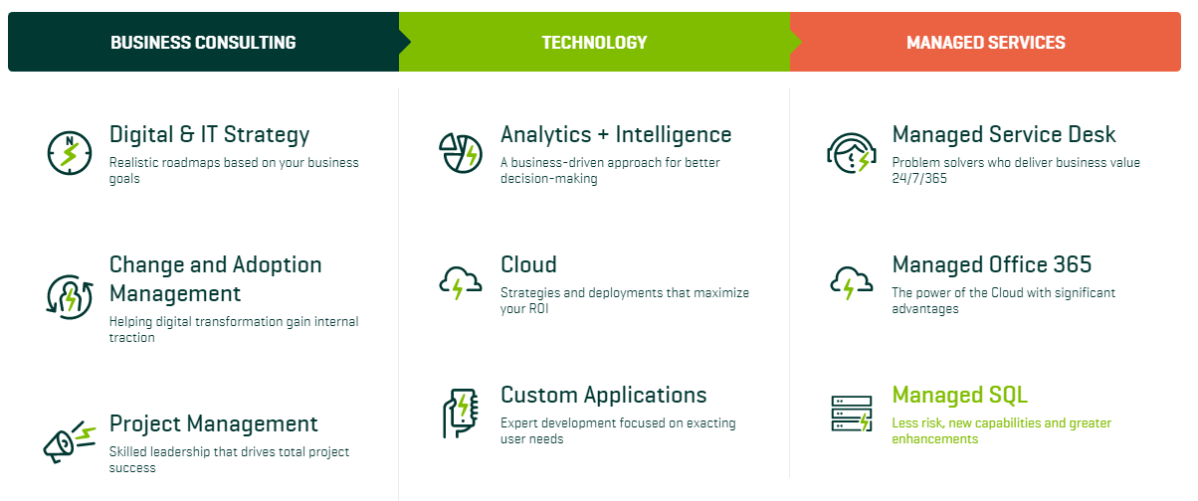
Sparkhound

Slide 88
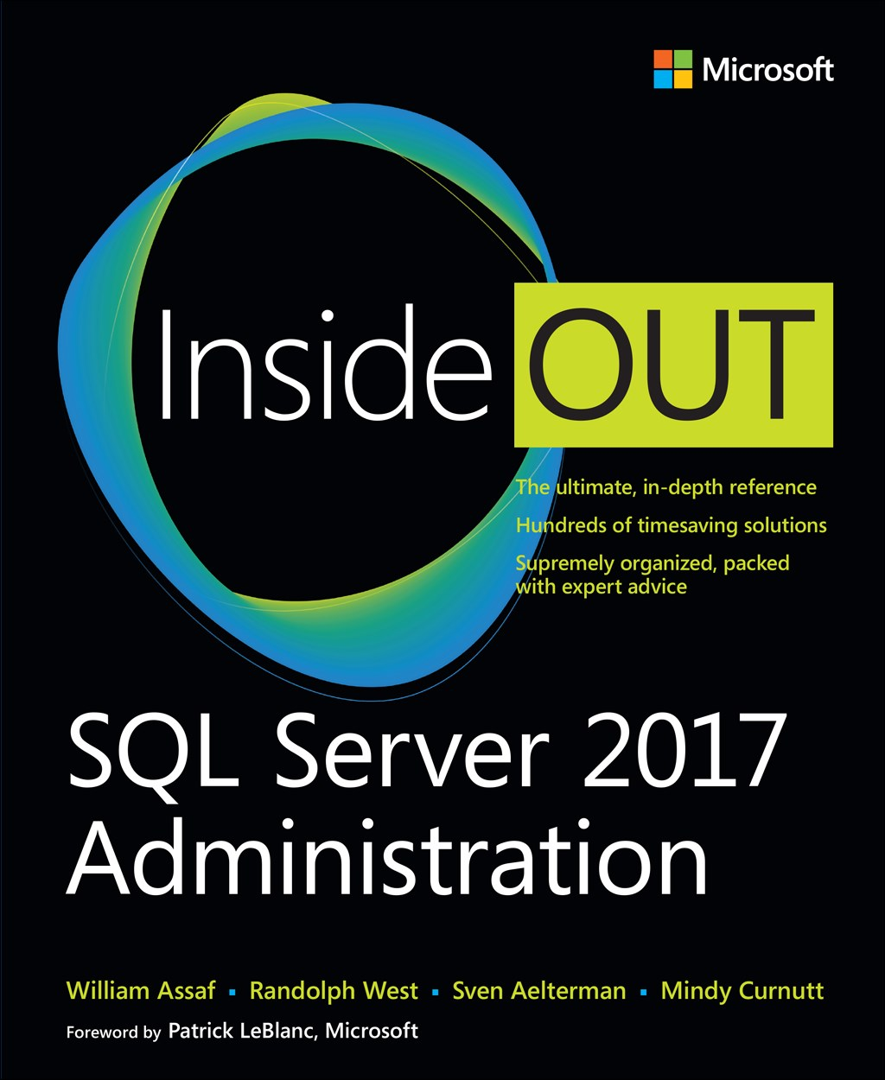
SQL Server 2017 Administration Inside Out
Published Feb 2018 by Microsoft Press
2nd edition for SQL 2019 coming Q4’2019*
*just a guess

Slide 89

Bio and contact
William D Assaf, MCSE
Baton Rouge SQL UG board, SQLSat organizer
PASS Regional Mentor
Principal Consultant, Manager at Sparkhound
Twitter: @william_a_dba
This presentation, including all source code, available at this SQLSaturday’s schedule page and at my blog:
SQLTact.com

